Slide 1


Pharmaceutical Sales Analytics Dashboard DEPI Graduation Project
Prepared By: •Abdulrhman Mohamed Fathi
•Andrawes Elia Attia Ibrahim
•Abdul Rahman Khalid Sayed
•Moamen Othman Abdel Hafeez Othman •Mahmoud Al-Amir Ramadan Suleiman
Track:
Data Analysis using Power BI

Slide 2
Project Idea Business Problem Pharmaceutical companies generate thousands of sales transactions across different pharmacies, products, and regions. However, analyzing this large amount of data manually is time-consuming and makes it difficult to identify sales trends, profitability, and business opportunities.

Slide 3
Project Idea Proposed Solution Develop an interactive Power BI dashboard that provides real-time business insights through KPIs, dynamic visualizations, and advanced analytics to support decision-making.

Slide 4
Project Idea Business Problem Pharmaceutical companies generate thousands of sales transactions across different pharmacies, products, and regions. However, analyzing this large amount of data manually is time-consuming and makes it difficult to identify sales trends, profitability, and business opportunities.

Slide 5
Project Idea Unique Value Proposition Interactive dashboards Business-focused KPIs Product profitability analysis Pharmacy performance analysis Promotion effectiveness analysis Dynamic filtering and drill-down capabilities

Slide 6
Project Wireframe •Dashboard Structure The solution consists of four interactive dashboard pages: •Executive Dashboard Provides an overview of overall business performance through KPIs and sales trends. •Medication Details Displays detailed information about pharmaceutical products. •Product & Pharmacy Analytics Analyzes product performance and compares pharmacies across different regions. •Business Problems & Opportunities Identifies low-profit products, promotion effectiveness, and improvement opportunities.

Slide 7
Dashboard Navigation Executive Dashboard ↓ Product & Pharmacy Analytics ↓ Medication Details ↓ Business Problems & Opportunities User Experience •Easy navigation •Interactive slicers •Responsive visualizations •Clear KPI presentation •Business-oriented insights

Slide 8
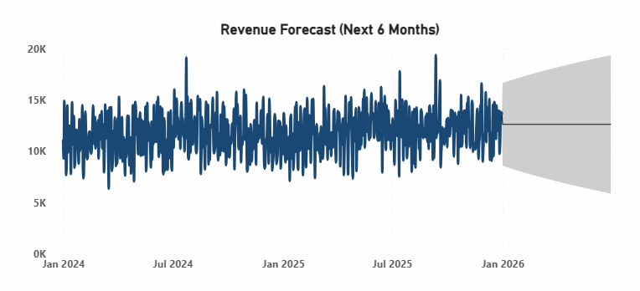
Revenue Forecast Purpose Predict future revenue based on historical sales data. Key Insight Revenue is expected to remain stable over the next six months with normal fluctuations. Business Value Supports budgeting, inventory planning, and strategic decision-making.

Slide 9
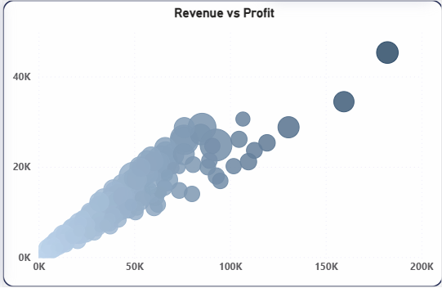
Revenue vs Profit Purpose Analyze the relationship between revenue and profit. Key Insight Higher revenue generally leads to higher profit, with a few outstanding high-performing sales. Business Value Helps identify profitable products and business opportunities.

Slide 10
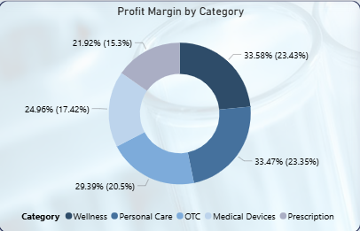
Profit Margin by Category Purpose Compare profit margins across product categories. Key Insight Wellness and Personal Care generate the highest profit contribution. Business Value Supports pricing, marketing, and product portfolio decisions.

Slide 11
End Users & Features Target Users Sales Manager Monitor revenue and profitability Track monthly sales trends Product Manager Analyze product performance Identify top and low-performing products Regional Manager Compare pharmacy performance Monitor regional sales
Key Features KPI Cards Interactive Filters Drill-down Analysis Business Problem Identification Promotion Analysis Geographic Analysis

Slide 12
Data Structure Data Model The project follows a Star Schema data model. Fact Table T_FactSales Contains: Revenue Cost Margin Units Sold Promotion Flag
Dimension Tables
T_DimProduct
Product Name
Brand
Category
T_DimPharmacy
Pharmacy
Region
T_DimDate
Date
Month
Quarter
Year
Medicine_Details
Medicine Description
Manufacturer
Medical Information
Benefits
Better Performance
Simplified Relationships
Optimized DAX Calculations

Slide 13
Power Query Data Cleaning Data Transformation ETL Process
Programming Languages & Tools
Technologies Used
Power BI Desktop
Dashboard Development
DAX
Developed KPIs including:
Total Revenue
Total Margin
Profit Margin %
Revenue per Pharmacy
Low Profit Products
Excel
Primary Data Source
Techniques Used
Star Schema
Data Modeling
KPI Design
Business Intelligence
Interactive Reporting

Slide 14
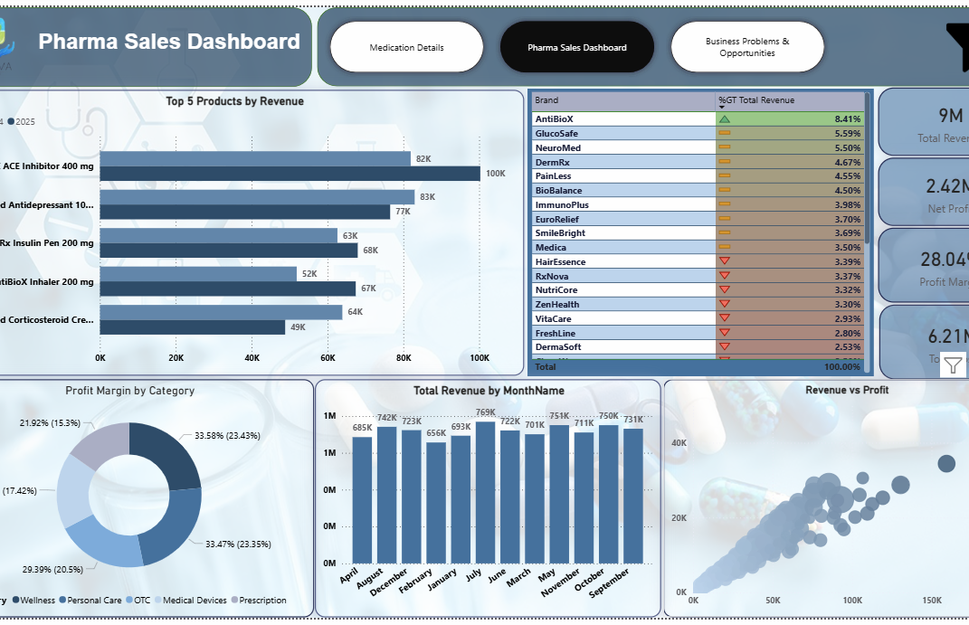
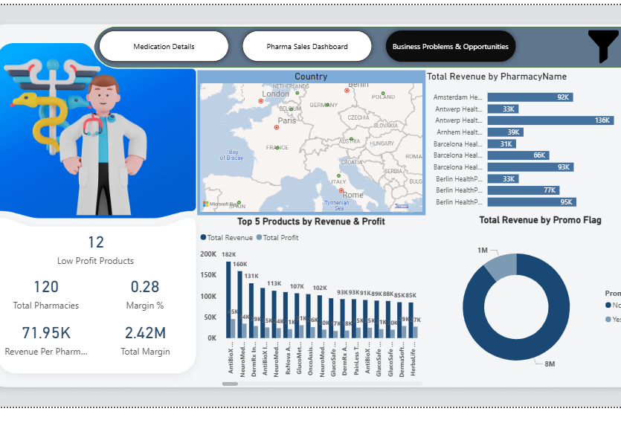
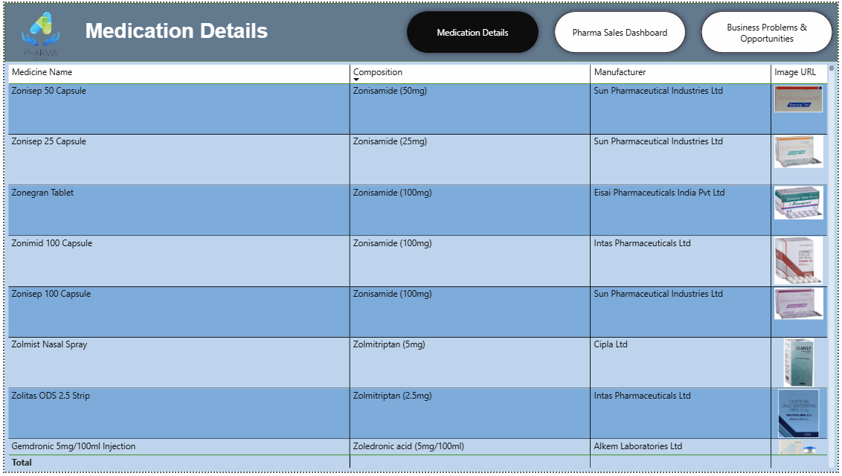
Live Dashboard Executive Dashboard •Medication Details Product & •Pharmacy Analytics •Business Problems & Opportunities

Slide 15
Key Business Insights Overall Performance Total Revenue reached 9M with a 28.04% Profit Margin, indicating strong business performance. The company generated a Net Profit of 2.42M across 120 pharmacies. Product Performance AntiBioX ACE Inhibitor 400 mg is the top-performing product by revenue. Wellness and Personal Care are the most profitable product categories. 12 products were identified as low-profit products and require further business analysis. Business Opportunities Revenue is concentrated in a few high-performing brands, creating opportunities to improve the performance of other products. Revenue forecasting predicts stable sales over the next six months, supporting future planning and inventory management. Promotion and pricing strategies should be optimized to improve profitability and maximize business growth.

Slide 16
Deliverables Final Deliverables Interactive Power BI Dashboard PBIX Project File Project Documentation PowerPoint Presentation Business Report DAX Measures Data Model

Slide 17
Project Team Team Member •Abdulrhman Mohamed Fathi •Andrawes Elia Attia Ibrahim •Abdul Rahman Khalid Sayed •Moamen Othman Abdel Hafeez Othman •Mahmoud Al-Amir Ramadan Suleiman
Responsibilities Data Cleaning Data Modeling DAX Development Dashboard Design Business Analysis Report Development

Slide 18
Thank You
Questions & Discussion
Email:
• Androelia2004@gmail.com
• 100bodybody@gmail.com
• abdulrahmankhaled9911@gmail.com
• moamenothman68@gmail.com
• asforalyamany1@gmail.com

